Slide 1



Introduction to GitHub Copilot
GitHub Copilot Development
Exploring AI assistance in coding workflows
by RocketMind academy
Notes:
AI-generated content may be incorrect. --- GitHub Copilot is an AI-powered code completion tool that assists developers by suggesting code snippets and entire functions. In this presentation, we will explore its features, benefits, integration with development environments, and how to get started with it.

Slide 2
01
Writing Better & Faster Code with GitHub Copilot

Slide 3

Enhancing Readability & Maintainability
Code Readability
Improving code readability is crucial for easier understanding and collaboration among developers, fostering better communication and maintenance.
Maintainability Practices
Implementing best practices in coding helps create maintainable code, making future updates and enhancements more efficient and less error-prone.
GitHub Copilot Integration
Utilizing GitHub Copilot can assist in writing better code by providing suggestions and automating repetitive tasks, enhancing productivity.

Slide 4
Key Features
Inline Code Completion
Provides inline code suggestions as ghost text, enhancing the coding experience by reducing keystrokes.
Whole Function Suggestions
Offers complete function suggestions based on comments or headers, streamlining the coding process.
Repetitive Code Generation
Automates the generation of repetitive code like getters and boilerplate, saving time and effort.
Algorithm Implementation Support
Assists developers in implementing algorithms effectively, providing guidance and suggestions.
Refactoring Suggestions
Gives refactoring suggestions via Copilot Chat, improving code quality and maintainability.

Slide 5
Demonstration Suggestions
Writing New Functions
Start writing a new function with clear comments to ensure better understanding and maintainability of the code.
Using Copilot Suggestions
Show Copilot suggesting a complete implementation, demonstrating its capability to assist in coding.
Cycling Through Suggestions
Cycle through multiple suggestions using Alt+] to explore various coding options for problem-solving.
Code Refactoring
Refactor existing code and consult Copilot Chat to enhance readability and optimize performance.

Slide 6

Code Examples
JavaScript Example
This JavaScript function generates a random alphanumeric string of a specified length, showcasing string manipulation and randomization techniques.
Java Example
This Java method checks whether a number is prime, illustrating control flow and mathematical operations in programming.
C# Example
This C# method determines if an input string is a palindrome, demonstrating string reversal and comparison techniques.

Slide 7
02
Speed Up Development

Slide 8

Inline Suggestions
Enhancing Development Speed
Inline suggestions can greatly enhance the speed of development by providing context-aware code completions, allowing for quicker coding.
Using Copilot Effectively
Accepting Copilot’s suggestions with the `Tab` key streamlines the coding process and improves efficiency.

Slide 9

Multi-Line Suggestions
Using Keyboard Shortcuts
Utilize keyboard shortcuts like `Ctrl + Enter` or `Cmd + Enter` to enhance productivity and efficiency when programming.
Cycling Through Suggestions
Cycle through multi-line suggestions to quickly access complete code blocks or API integrations, saving time and effort.

Slide 10

Debugging Assistance
Using Copilot Chat
Utilize Copilot Chat by pasting error messages to receive relevant debugging assistance and solutions.
Error Message Analysis
Analyzing error messages is crucial for identifying and resolving issues in your code efficiently.
Fixing Vulnerabilities
Request assistance for fixing security vulnerabilities such as SQL injection through the chat tool.

Slide 11
03
Refactoring

Slide 12
Improve Code Readability
Variable/Function Renaming : Ask Copilot to rename ambiguous identifiers (e.g., x → userInput).
Add Comments : Use prompts like "Explain this function in a comment"
Consistent Style : Enforce formatting rules via .github/copilot-instructions.md (e.g., "Use PascalCase for component names")
# Before
def calc(a, b): return a * b
# After
def calculate_discount(original_price, discount_rate):
return original_price * discount_rate

Slide 13
Lint Errors and Code Quality
Identify and resolve syntax errors, unused variables, or security vulnerabilities.
Use Copilot Chat to ask: "Fix all ESLint errors in this file"
Integrate with tools like ESLint or Prettier for automated formatting.
// Before
if (error) console.log("Error occurred");
// After
if (error) {
console.log("Error occurred");
}

Slide 14
Performance Optimization
Replace inefficient data structures (e.g., use hashmaps instead of nested loops)
Reduce time complexity in algorithms (e.g., convert O(n²) to O(n) with caching).
Use Copilot Chat to ask: "Optimize this sorting function for large datasets"
# Before (O(n²))
result = [x for x in data if x > 0]
# After (O(n))
result = list(filter(lambda x: x > 0, data))

Slide 15
Design Patterns and Architecture
Generate boilerplate for patterns like Repository, Strategy, or Observer.
Use prompt files to enforce architectural guidelines (e.g., "Implement the Repository Pattern for data access layers“)
// Repository Pattern Template
public interface IProductRepository {
Product GetById(int id);
void Add(Product product);
}

Slide 16
Decoupling Business Logic
Move business logic out of UI components (e.g., React hooks).
Use Copilot to extract logic into utility files or services
// Before (tightly coupled)
function UserProfile({ user }) {
const formattedDate = new Date(user.createdAt).toLocaleDateString();
return <div>{formattedDate}</div>;
}
// After (decoupled)
function formatDate(date) {
return new Date(date).toLocaleDateString();
}

Slide 17
Simplify Inheritance Hierarchies
Ask Copilot: "Refactor this class hierarchy to use composition"
Use prompt files to enforce principles like "Prefer composition over inheritance" [File ).
// Before (inheritance)
class AdminUser extends User { /* ... */ }
// After (composition)
class User {
private role: Role;
}

Slide 18
Fixing Database Deadlocks
Identify deadlocks in transaction code and suggest fixes (e.g., reordering queries).
Use Copilot Chat: "Fix this SQL deadlock in the transaction block"
-- Before (unordered updates)
UPDATE orders SET status = 'paid' WHERE id = 1;
UPDATE customers SET balance = 0 WHERE id = 100;
-- After (consistent order)
UPDATE customers SET balance = 0 WHERE id = 100;
UPDATE orders SET status = 'paid' WHERE id = 1;

Slide 19
04
Automated Documentation Generation

Slide 20
Inline Comments & Docstrings
Generating Inline Comments
Use the right-click context menu to add comments that explain your code clearly, enhancing readability.
Docstring Templates
Typing specific symbols like `/**` or `"""` triggers Copilot to generate structured docstring templates for your functions.

Slide 21

API Documentation
Swagger/OpenAPI Integration
Integrating Swagger or OpenAPI allows for streamlined API documentation and better visualization of endpoints.
Using Copilot for Documentation
Utilize Copilot to automatically draft API endpoint descriptions and generate request/response examples.
Creating README Files
A well-structured README file includes setup instructions, usage examples, and project details for users.

Slide 22

Non-Technical Stakeholder Docs
Importance of Plain-Language
Plain-language explanations are crucial for effective communication with non-technical stakeholders, ensuring clear understanding.
Engaging Non-Technical Audiences
Using approachable language helps engage non-technical audiences, making complex ideas more accessible.
Utilizing Copilot's Help
Asking tools like Copilot to simplify technical jargon can aid in producing understandable documentation.

Slide 23
Debugging
Exceptions | See Debug an exception with Copilot in this article. Help with exceptions includes help with deadlock detection errors.
Variables | See Debug using Copilot in this article.
Data tips | See Get AI assistance with Data tips.
Conditional breakpoints and tracepoints | See Get suggestions with conditional breakpoints and tracepoints in this article.
Quick Actions (light bulb) | See Get AI assistance with Quick Actions.
IEnumerable tabular visualizer | See Modify the visualizer expression.
Inline return values | See View return values of method calls.
Summary thread descriptions | See Threads View (Parallel Stacks).
Auto insights for profiling

Slide 24
05
Writing Tests Efficiently

Slide 25

Unit Test Generation
Automate Test Creation : Generate unit, integration, and end-to-end tests directly in your code editor
Edge Case Coverage : Automatically create tests for error conditions and boundary scenarios
Framework Setup : Get help configuring testing frameworks (e.g., xUnit, Vitest) and extensions
Failing Test Fixes : Use Copilot to debug and fix failing tests with suggestions
Consistency : Personalize test generation to follow project-specific standards (e.g., naming conventions)

Slide 26
Integration & Edge Case Coverage
Setup Framework :
Use /setupTests in Copilot Chat to configure your testing environment
Generate Tests :
Editor Smart Actions : Right-click → Copilot > Generate Tests
Inline Prompts :
"Generate tests for this code"
"Write unit tests including edge cases"
"Create integration tests for this module"
Fix Failing Tests :
Use /fixTestFailure in Copilot Chat or click the Fix Test Failure button in Test Explorer
Slash Commands :
Use /tests to trigger test-specific workflows (e.g., mocks, end-to-end tests)

Slide 27
Unit tests
Automated Test Generation :
GitHub Copilot Chat generates unit tests for functions, reducing manual effort
Supports multiple frameworks (e.g., unittest for Python, xUnit for C#)
Edge Case Coverage :
Automatically includes tests for boundary conditions (e.g., invalid inputs, error handling)
Framework Setup :
Assists in configuring testing environments (e.g., installing dependencies, initializing test files)

Slide 28
Unit tests
import unittest
from generate_unit_tests import validate_price
class TestValidateProduct(unittest.TestCase):
def test_price_zero(self):
with self.assertRaises(ValueError):
validate_price(0)
def test_price_above_limit(self):
with self.assertRaises(ValueError):
validate_price(1500)
def test_price_edge_case_max(self):
try:
validate_price(1000)
except ValueError:
self.fail("validate_price() raised ValueError unexpectedly!")
/tests Generate unit tests for this function. Validate both success and failure and include edge cases.
def validate_price(price: float):
if price <= 0:
raise ValueError("Price must be greater than 0")
if price > 1000:
raise ValueError("Price must be less than or equal to 1000")

Slide 29
Unit tests
Specify Test Types :
Include prompts like "Use pytest" or "Include parameterized tests" for framework-specific output
Cover Edge Cases :
Explicitly request tests for boundary values (e.g., price = 0, price = 1000)
Validate Generated Code :
Review tests for correctness and adjust assertions as needed
Reuse Existing Templates :
Use #file: path/to/test.py to align generated tests with your project’s style

Slide 30
Mock Objects
Mock Objects : Simulate real dependencies (e.g., databases, APIs) to isolate code under test, ensuring reliability and speed
Copilot’s Role :
Generates mock implementations based on your codebase and testing framework (e.g., Jest , Vitest , Sinon ).
Automates boilerplate setup (e.g., stubbed methods, test assertions)

Slide 31
Mock Objects
Prompt :
"Generate a mock for this Angular service using Jest."
"Create a mock object for the Logger interface with ts-auto-mock."
Include #file: path/to/test.js to align with existing test patterns
Output : Copilot provides:
Mock setup (e.g., Jest’s jest.fn(), Sinon stubs).
Test assertions to verify interactions
Best Practices
Isolation : Focus tests on the unit of code, not external systems
Customization : Refine prompts to specify frameworks (e.g., "Use Jest for mocking").
Validation : Review generated mocks for accuracy and adjust as needed

Slide 32
End to end tests
Challenge : E2E testing is time-consuming due to dynamically generated HTML and complex user interactions
Solution : GitHub Copilot Chat generates test scripts (e.g., Playwright, Selenium) to automate interactions and validate outcomes
Benefits :
Reduces manual coding effort.
Ensures coverage of critical user workflows (e.g., form submissions, error handling).
Example Use Case : Testing a React product details page with dynamic data fetching.

Slide 33
End to end tests
Prompt :
"Using Playwright, generate an E2E test to ensure the product displays correctly."
Generated Test Code :
Mocks API responses for success/error scenarios.
Validates loading states, product details, and error messages.
test('displays product details correctly', async ({ page }) => {
await page.goto('/product/1');
await expect(page.locator('h2')).toHaveText('Test Product');
await expect(page.locator('text=Price: $99.99')).toBeVisible();
});
Framework Flexibility : Works with Selenium, Cypress, or Playwright

Slide 34
End to end tests
Mock APIs : Use route mocking (as shown) to isolate frontend behavior from backend dependencies
Validate States : Include tests for loading, success, and error states.
Reusable Prompts : Refine prompts for framework-specific output (e.g., "Use Selenium for E2E testing").
Alternative Tools :
Selenium : Ideal for cross-browser testing
Cypress : Excellent for real-time debugging and DOM assertions.
Nightwatch : Simplifies test setup for Node.js projects

Slide 35
Test Failure
Fix Failing Tests :
Hover over a failing test in VS Code → Click the sparkle icon → Apply Copilot’s suggested fix
Use /fixTestFailure for detailed guidance
Personalize Test Generation :
Provide custom instructions to Copilot, such as:
Preferred frameworks (e.g., Jest, Playwright).
Naming conventions (e.g., test_price_validation()).
Specific patterns (e.g., parameterized tests)
Agent Mode : Automatically rerun and fix tests after modifications

Slide 36
Test Documentation
Importance of Comments
Explanatory comments in tests help clarify the purpose and expected outcomes, improving code readability for future developers.
Role of Copilot
Copilot assists developers by automatically adding helpful comments, streamlining the test documentation process for efficiency.

Slide 37
06
Git Integration with GitHub Copilot

Slide 38

Interacting with Git Repositories
Initializing and Cloning Repositories
Use commands like 'git init' and 'git clone ' to set up your Git repositories effectively.
Tracking Changes
Track your changes and back them up to GitHub using commands like 'git add .', 'git commit', and 'git push'.
Branch Management
Manage branches by creating and switching them using commands like 'git checkout -b '.

Slide 39

Comparing Changes
Using Git Diff
Utilize `git diff` in the terminal to compare changes in your working tree against specific commits.
GitHub Insights
Access the 'Insights' tab on GitHub to review file-by-file diffs and commit history for better tracking.
Visual Studio Integration
Open the Git Repository Window in Visual Studio to inspect changes, resolve conflicts, or stage files efficiently.

Slide 40

Creating Pull Requests (PRs)
Manual PR Creation
Learn how to create pull requests manually by pushing changes and using GitHub's interface effectively.
Visual Studio Shortcut
Utilize the Visual Studio shortcut to create a new pull request quickly without navigating away from the IDE.
Using GitHub Copilot
Enhance your workflow by using GitHub Copilot to automatically generate summaries for pull requests.

Slide 41

Reviewing and Merging PRs
Sync Repositories
Utilize GitHub’s PR interface to ensure all changes are verified across branches before proceeding to merge.
Automated Checks
Set up default Build/Run/Test commands in Copilot Workspace to automate PR validation and ensure code quality.
Merge Conflicts
Resolve merge conflicts efficiently using Visual Studio’s Git tools or the terminal commands like git merge and git rebase.

Slide 42
07
GitHub Workflows in VS Code

Slide 43

Features
Auto-suggest Commit Messages
The auto-suggest feature enhances productivity by providing relevant commit message suggestions based on code changes.
Compare Changes
VS Code allows users to compare changes visually, making it easier to understand differences between versions.
Create Pull Requests
The platform suggests titles and descriptions when creating pull requests, streamlining the review process.
Copilot Chat Feature
Copilot Chat can summarize or explain code differences, aiding developers in understanding changes effectively.

Slide 44
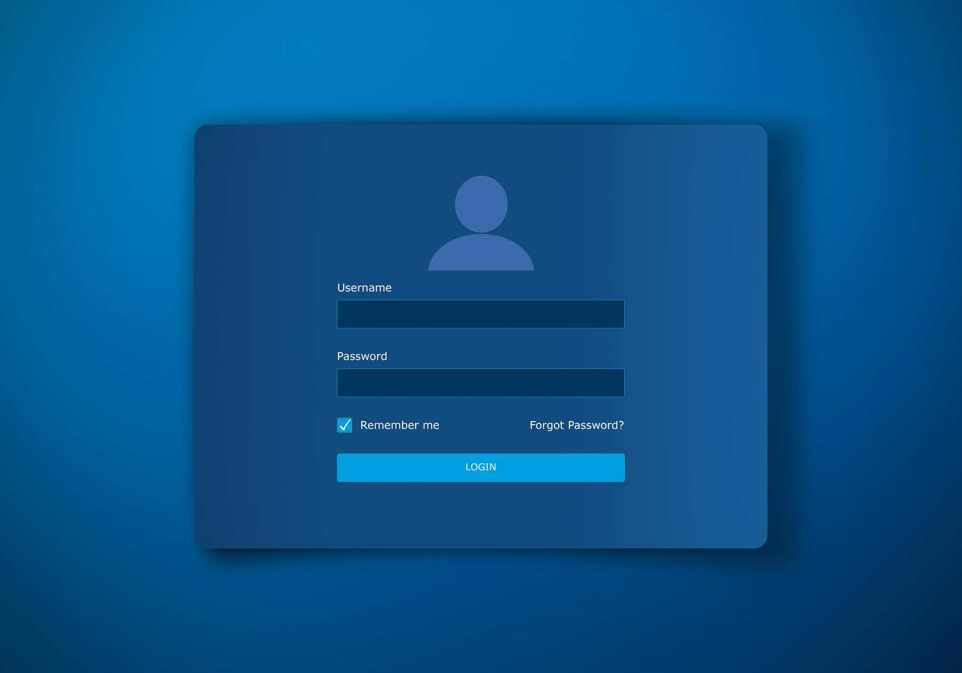
Demonstration Suggestions
Committing Changes
Demonstrate modifying a line of code and using Copilot to assist with commit messages.
Comparing Changes
Show how to compare modified files and view differences in the code using the diff viewer.
Creating a Pull Request
Illustrate the process of creating a pull request in GitHub with Copilot's suggestions for title and description.
Reviewing Diffs with Copilot Chat
Demonstrate the use of Copilot Chat to explain code changes in the diff view.

Slide 45
Best Practices
Review Commit Messages
Always review AI-suggested commit messages and pull request descriptions to ensure clarity and accuracy.
Use AI as a Tool
Utilize AI tools like Copilot to enhance documentation processes but maintain personal judgment in the content.
Clarify Pull Requests
Clearly define the scope of pull requests and articulate key decisions for better understanding among reviewers.

Slide 46
08
Iterating and Reviewing

Slide 47

Strategies
Cycling Through Suggestions
Utilize keyboard shortcuts to navigate through suggestions efficiently. This helps in quickly finding the most suitable options.
Using Copilot Chat
Engage with Copilot Chat to receive optimized or refactored advice for your work, enhancing productivity.
Editing and Re-prompting
Edit your prompts and re-prompt for better responses, ensuring more accurate and relevant completions.

Slide 48

Example Scenario
Initial Prompt
The initial prompt provides a basic requirement to check if a number is even.
First Suggestion
The first suggestion correctly checks evenness but lacks complexity for business rules.
Refined Prompt
The refined prompt specifies the need for a more informative output, returning 'Yes' or 'No'.
Improved Suggestion
The improved suggestion provides the correct output format aligned with the expected behavior.

Slide 49
Quality Control
Draft Review Process
AI outputs should be treated as initial drafts, requiring thorough review and consideration before finalization.
Testing AI Code
Always validate and test AI-generated code to ensure functionality and correctness before deployment.
Using Linters and CI
Implement linters and Continuous Integration (CI) to catch errors early in the development process, improving code quality.

